Slide 1
Diesel-to-Natural Gas Engine Conversions
“A cost-effective alternative to new natural gas vehicles”
Presented by:
Werner Funk, CEO
Omnitek Engineering Corp.
Notes:
“Diesel-to-Natural Gas Engine Conversions”
An introduction to a cost-effective alternative to new natural gas vehicles
1

Slide 2
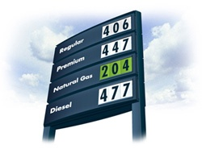
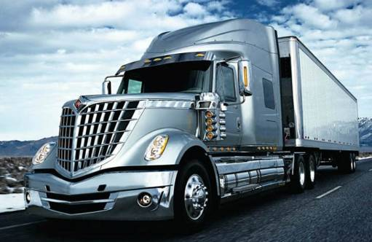
Why Natural Gas?
FACT
The high cost of diesel fuel and environmental policies have forced trucking fleets to look for an affordable option to transition their fleets to natural gas.
Natural Gas
Inexpensive and domestic fuel
Clean Burning
Low CO2 emissions
Virtually no PM
Supports policies for a sustainable
energy future
Reduces dependency on foreign oil
2
Notes:
High fuel costs and air pollution concerns, as well as talks around energy security,
has forced trucking fleets to look for an affordable option to transition their fleets to natural gas.
Natural Gas is inexpensive and clean burning
It has low CO2 emissions and virtually no PM
It is Made in America and it supports policies for a sustainable energy future
It also reduces oil imports

Slide 3
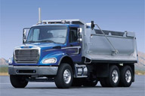
Natural Gas Fleet - Options
How to transition a fleet from diesel to natural gas?
The Alternatives
New NG Trucks & Buses
- Limited product offerings
- High cost
Diesel Dual-Fuel Technology
- Only uses limited amounts of natural gas
The Real Solution!
Diesel-to-Natural Gas Engine Conversions
Most economical option to transition a fleet to natural gas.
Diesel engines have a service life of up to 20 years, so
why replace them early?
Convert diesel engines to natural gas!
3
Notes:
The question is, how do you transition a fleet from diesel to natural gas?
There are few options:
A fleet can buy new NG trucks, but product offering are limited and new trucks are very expensive.
Diesel Dual Fuel technology is an option, but it only uses limited amounts of natural gas,
Offering lower money savings potential.
But there is another option!
Diesel-to-natural gas engine conversions -
It is the most economical option available to fleets
Diesel engines have a service life of up to 20 years, so why replace them early
if they still have many years of service left in them? - These diesel engines can be convert to natural gas?
This affordable and cost effective option accelerates transition to natural gas

Slide 4
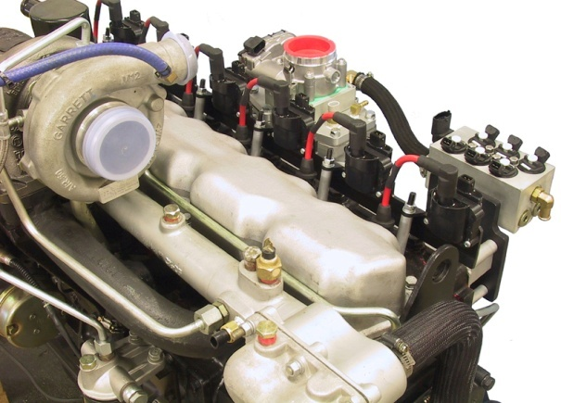
The Omnitek Solution
Engine Conversions
– A feasible and affordable option!
Omnitek Solution
Omnitek has developed a technology that can be used to convert diesel engines into 100% dedicated natural gas engines, at a fraction of the cost of a new natural gas engine.
Patented technology assures low emissions,
low fuel consumption, high engine power
and reliable engine operation.
US Patent Nr. 11/810,620
4
Notes:
Engine conversions – is a feasible and affordable option!
Omnitek has developed a technology that can be used to convert diesel engines
into 100% dedicated natural gas engines, at a fraction of the cost of a new natural gas engine.
Patented technology assures low emissions, low fuel consumption, high engine power and reliable engine operation.
4

Slide 5
How Does It Work
Given their long service life, every year thousands of diesel engines undergo routine overhauls.
Why not convert these engines to natural gas at that time?
Engine conversion not unlike an engine overhaul.
With the Omnitek conversion technology diesel engines are “overhauled” into 100% dedicated natural gas engines -- the difference in cost is minimal.
Diesel-to-natural gas engine conversions is a viable and cost-effective option
to transition a fleet to natural gas in a reasonable amount of time.
Engine manufacturers offer no solution for millions of in-use diesel engines!
5
Notes:
How Does It Work?
Given their long service life, every year thousands of diesel engines undergo routine overhauls.
Why not convert these engines to natural gas at that time?
An engine conversion is just like an engine overhaul
With the Omnitek conversion technology diesel engines are “overhauled” into 100% dedicated natural gas engines
-- and the difference in cost is minimal.
Diesel-to-natural gas engine conversions is a viable and cost-effective option to transition a fleet
to natural gas in a reasonable amount of time.
In the meantime, engine manufacturers offer no solution for millions of in-use diesel engines!

Slide 6
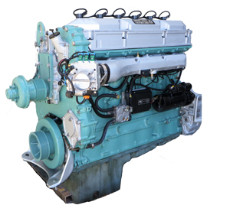
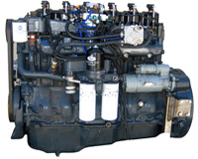
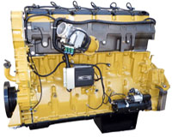
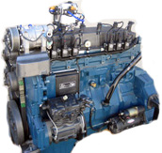
Omnitek DNG Engines
Omnitek DNG Engines
Omnitek has developed EPA legal DNG engine conversion kits for following engine models:
Navistar DT466 - 1996 to 2003
Navistar DT530 - 1996 to 2003
Mack E7 - 1994 to 2006
Detroit Diesel 60S - 1988 to 2009
Caterpillar C15 - 1993 to 2006
OTHERS AVAILABLE FOR NON-EPA & EXPORT MARKETS!
Some of the engines under development:
Mack MP7/MP8, CAT C13, C15, Cummins B, C, ISL, ISM, ISX
Navistar DT466 Maxxforce, Detroit Diesel MB4000 and 900
6
Notes:
As of November 2014, Omnitek has developed EPA legal DNG engine conversion kits for following engine models:
Many more available for non-EPA and Export markets
6

Slide 7
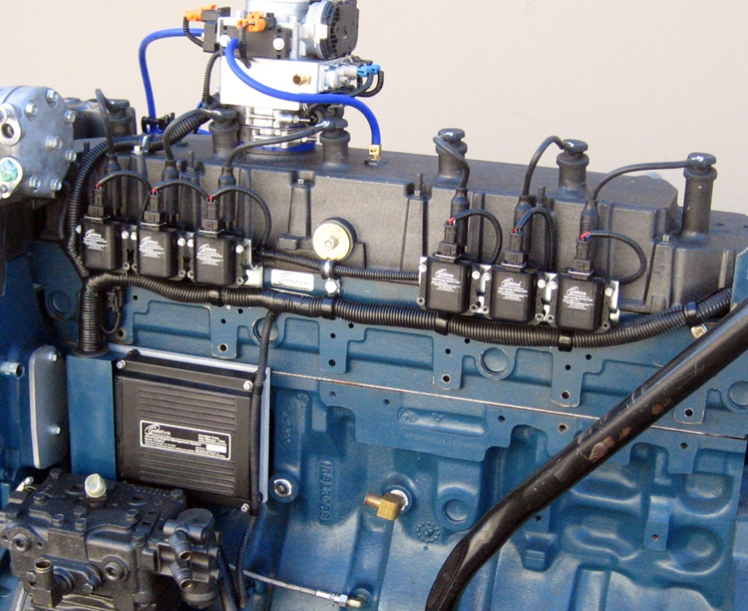
“Drop-In” DNG Engines
Diesel-To-Natural Gas Converted Engines (DNG)
Strategic alliance Omnitek / Reviva
“Drop-in” natural gas converted engines,
remanufactured to as-new condition
Assembly line remanufacturing/conversion process
assures consistency and highest quality
Engines are 100% dyno tested and
configured for quick installation
- short fleet conversion process.
Warranty on Parts and Labor:
3 Years / 100,000 Miles
Engine Remanufacturing Company
EPA Approved
Navistar DT466
Engine Conversion
7
Notes:
Drop-in DNG Engines
Omnitek has entered into a Strategic Alliance with Reviva to produce
“Drop-in” natural gas converted engines, remanufactured to as-new condition
Assembly line remanufacturing/conversion process assures consistency and highest quality
Engines are 100% dyno tested and configured for quick installation,
The ability to deliver “drop-in” engines shortens fleet conversion process.
7

Slide 8
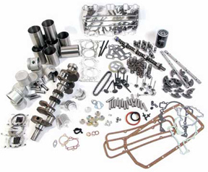
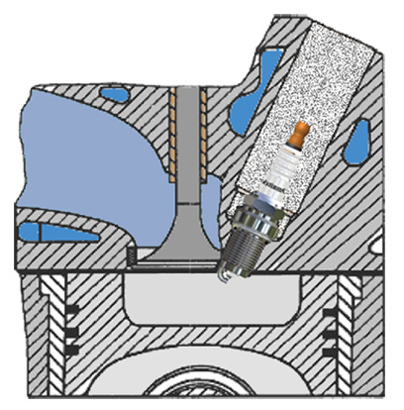
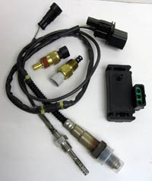
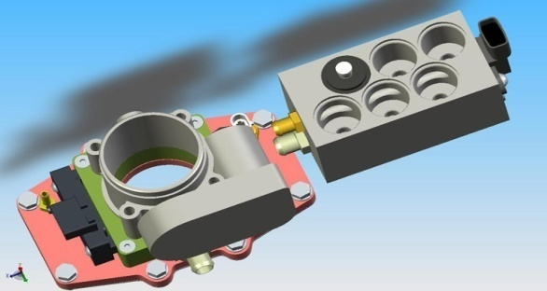
Natural Gas Conversion Steps
Engine conversion just like an engine overhaul.
Conversion Steps
Disassemble engine
Check components and replace accordingly
Install low-compression NG pistons
Install high-temperature valves and valve seats
Modify cylinder head for spark plugs
Reassemble engine
Install various sensors, fuel injectors
and ignition system
Install catalytic converter
Install NG storage tanks
8
Notes:
Here are the steps to convert a truck to natural gas?
The engine conversion is just like an engine overhaul.
The engine is disassembled and all components inspected and replace as necessary.
Low-compression NG pistons are installed, as well as high-temperature valves and valve seats.
The cylinder head is modified for spark plugs and the engine is reassembled.
Then the engine management system and natural gas fuel injectors are installed.
The vehicle also gets a catalytic converter and
NG storage tanks, which can be either CNG or LNG.

Slide 9
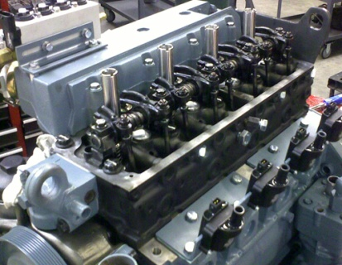
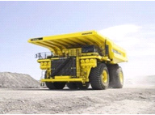
Conversion Value Proposition
Example: Conversion Class 6 Truck - USA:
Truck using 1,000 gallons of diesel per month
Diesel at $ 4.00 / $ 4,000 per month in fuel costs
Natural gas 50% of diesel – savings $ 2,000 /month
Rate of Return (ROR) is 19 months
Annual fuel savings for a fleet of 100 trucks would be $ 2,400,000
Large trucks, generators, locomotives, or ships cost more
to convert, but offer similar ROR.
Private Station
low-cost CNG,
ROR 12–14 month
9
Notes:
Here is an example showing the cost for a Class 6 truck conversion in the USA:
The converted “as-new” engine $ 24,000
The cost of the CNG tanks $ 8,000
The labor cost for the conversion $ 6,000
Total cost of the truck conversion $38,000
A Truck using 1,000 gallons of diesel per month with diesel at $4, will spend $4,000 per month on fuel.
Natural gas at half the cost, fuel savings are $2,000 /month
This results in a ROR of 19 months.
If the fleet has a Private CNG Station and low-cost natural gas, ROR can be only 12 – 14 month.
Annual fuel savings for a fleet of 100 trucks would be $ 2,400,000
Large mining trucks, generators, locomotives or ships cost more to convert, but offer similar ROR.

Slide 10
Not every vehicle is a good candidate for a DNG engine conversion! > Driving Range - Space for CNG tanks? > Power Needed - On some engines power is reduced. Can safely offer 30 - 35 hp/liter, or 120 lb-ft/liter Challenges: Integration with AT Transmissions, Gauges and Body Control Modules (CANbus, J1939, J1587) Fleets must invest in training drivers. Maintenance departments must invest in training technicians and upgrade maintenance facility. Expectations must be reasonable: – Money savings potential – Engine power – Driving range – Access to fueling infrastructure
Conversion Evaluation
Notes:
10
Not every vehicle is a good candidate for an engine conversion.
So before beginning the conversion process, we need to evaluate the project.
For instance:
What is the driving range of the vehicle – is there space for enough CNG tanks?
What is the engine power needed? On some engines the power may be reduced some.
It is pretty safe to make 30 - 35 hp per liter of engine displacement or 120 lb-ft of torque.
There are Challenges: The Integration with Auto Transmissions / Gauges (CANbus, J1939, J1587) Fleets must invest in training drivers. Maintenance departments must invest in training technicians
and upgrade maintenance facility. Expectations must be reasonable: – Money savings potential – understand RoR before conversion – Engine power – how is the vehicle used? – Driving range – Access to fueling infrastructure

Slide 11
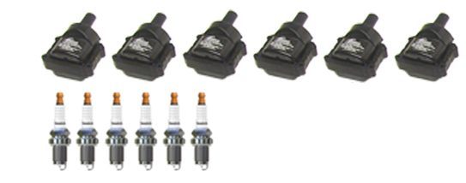
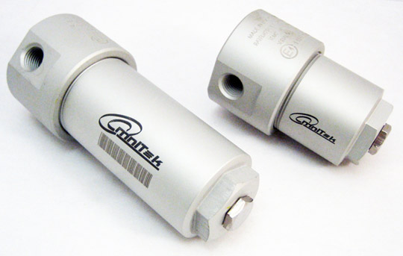
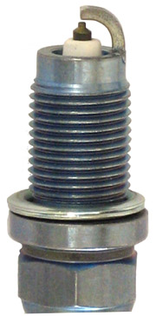
Maintenance
FLEETS BE AWARE!
Natural gas engines require specific maintenance items and procedures.
Training on the Omnitek System!
Service Items:
CNG Engine Oil - VERY IMPORTANT
>oil testing can extend oil change intervals
Premium Spark Plugs
Ignition Coils
Oxygen Sensor
Natural Gas Filter - Removes oil mist and particulates
>replace often
Notes:
11
FLEETS BE AWARE! Natural gas engines require specific maintenance items and procedures.
Service Items:
CNG Engine Oil - VERY IMPORTANT. Oil testing can extend oil change intervals.
Premium Spark Plugs
Spark Plug Wires
Ignition Coils
Oxygen Sensor
Natural Gas Filter - Removes oil mist and particulates
>replace often<

Slide 12
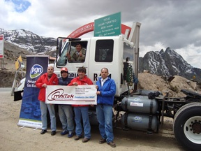
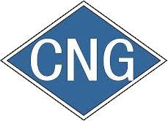
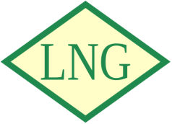
Omnitek Technology Applied
Omnitek has validated the diesel-to-natural gas engine conversion
technology with over 5,000 engine conversions worldwide.
Technical support is available in 12 countries.
Technology can be used to convert diesel engines of all sizes: Truck / Bus / Generator / Locomotive / Ship
Advanced Omnitek technology can be used with:
- Compressed Natural Gas (CNG)
- Liquid Natural Gas (LNG)
- Biogas (RNG).
WORLD RECCORD
Omnitek-converted CNG Truck at 4800 meters above sea level.
12
Notes:
Omnitek has validated the diesel-to-natural gas engine conversion technology
with over 5,000 engine conversions worldwide.
Technical support is available in 12 countries.
The technology can be used to convert diesel engines of all sizes:
Trucks / Buses / Generators / Locomotives / Ships
And
Can be used with:
- Compressed Natural Gas (CNG), Liquid Natural Gas (LNG) or Biogas (RNG)

Slide 13
To Summarize
Omnitek DNG engine conversion technology - economical solution for fleets looking to transition vehicles to 100% natural gas.
Convert diesel engines to natural gas
No more EGR, DPF, SCR or Diesel Exhaust Fluid (DEF).
Keep your engine brand.
Accelerates transition to natural gas
Capitalize on the long service-life of diesel engines
Notes:
13
To Summarize
The Omnitek diesel-to-natural gas engine conversion technology offers an economical solution for fleets looking to
transition to natural gas.
Convert diesel engines to natural gas.
No more EGR, DPF, SCR or Diesel Exhaust Fluid (DEF).
Keep your engine brand.
If you have a Yellow engine – keep your yellow engine.
If you have a Blue engine – keep your blue engine.
Natural gas engines don’t all have to be Red.
Engine conversions accelerates transition to natural gas
Capitalize on the long service-life of diesel engines

Slide 14
Thank You!
Contact
Werner Funk, CEO
Omnitek Engineering Corp.
(1) 760-591-0089
info@omnitekcorp.com
www.omnitekcorp.com
14
Notes:
14

